Slide 1

Employment attrition
Name: Deepti Horakeri
Batch : B5 Online
Date: 27/02/2025

Slide 2
Introduction:
Purpose of the Dataset – The dataset provides insights into employee attrition and workplace characteristics.
Objective – To analyze employee behavior, satisfaction, and factors contributing to attrition.
Data Scope – Covers demographic, job-related, performance, and satisfaction metrics of employees.
Business Impact – Helps in understanding employee retention patterns and improving HR policies.
Analysis Goal – To identify key drivers of employee attrition and suggest data-driven solutions.

Slide 3
Dataset Overview:
1. Age – Employee’s age in years.
2. Attrition – Whether the employee has left the company (Yes/No).
3. BusinessTravel – Frequency of business travel.
4. DailyRate – Employee’s daily wage.
5. Department – Department where the employee works.
6. DistanceFromHome – Distance between home and office.
7. Education – Employee’s education level.
8. EducationField – Employee’s field of study.
9. EmployeeCount – Likely a constant value.
10. EmployeeNumber – Unique identifier for each employee.
11. EnvironmentSatisfaction – Work environment satisfaction.
12. Gender – Employee’s gender.
13. HourlyRate – Employee’s hourly wage.
14. JobInvolvement – Employee’s engagement level.
15. JobLevel – Employee’s seniority level.

Slide 4
16. JobRole – The employee’s job title.
17. JobSatisfaction – Employee’s job satisfaction level.
18. MaritalStatus – Employee’s marital status.
19. MonthlyIncome – Employee’s monthly salary.
20. MonthlyRate – The total monthly salary rate.
21. NumCompaniesWorked – Number of previous companies.
22. Over18 – Indicates if the employee is over 18.
23. OverTime – Whether the employee works overtime.
24. PercentSalaryHike – Percentage increase in salary.
25. PerformanceRating – Employee's performance rating.
26. RelationshipSatisfaction – Workplace relationships satisfaction.
27. StandardHours – Standard work hours.
28. StockOptionLevel – Employee’s stock option benefits.
29. TotalWorkingYears – Total work experience.
30. TrainingTimesLastYear – Number of training sessions attended.
31. WorkLifeBalance – Work-life balance rating.
32. YearsAtCompany – Years spent at the company.
33. YearsInCurrentRole – Years in the current position.
34. YearsSinceLastPromotion – Time since last promotion.
35. YearsWithCurrManager – Years under the current manager.

Slide 5
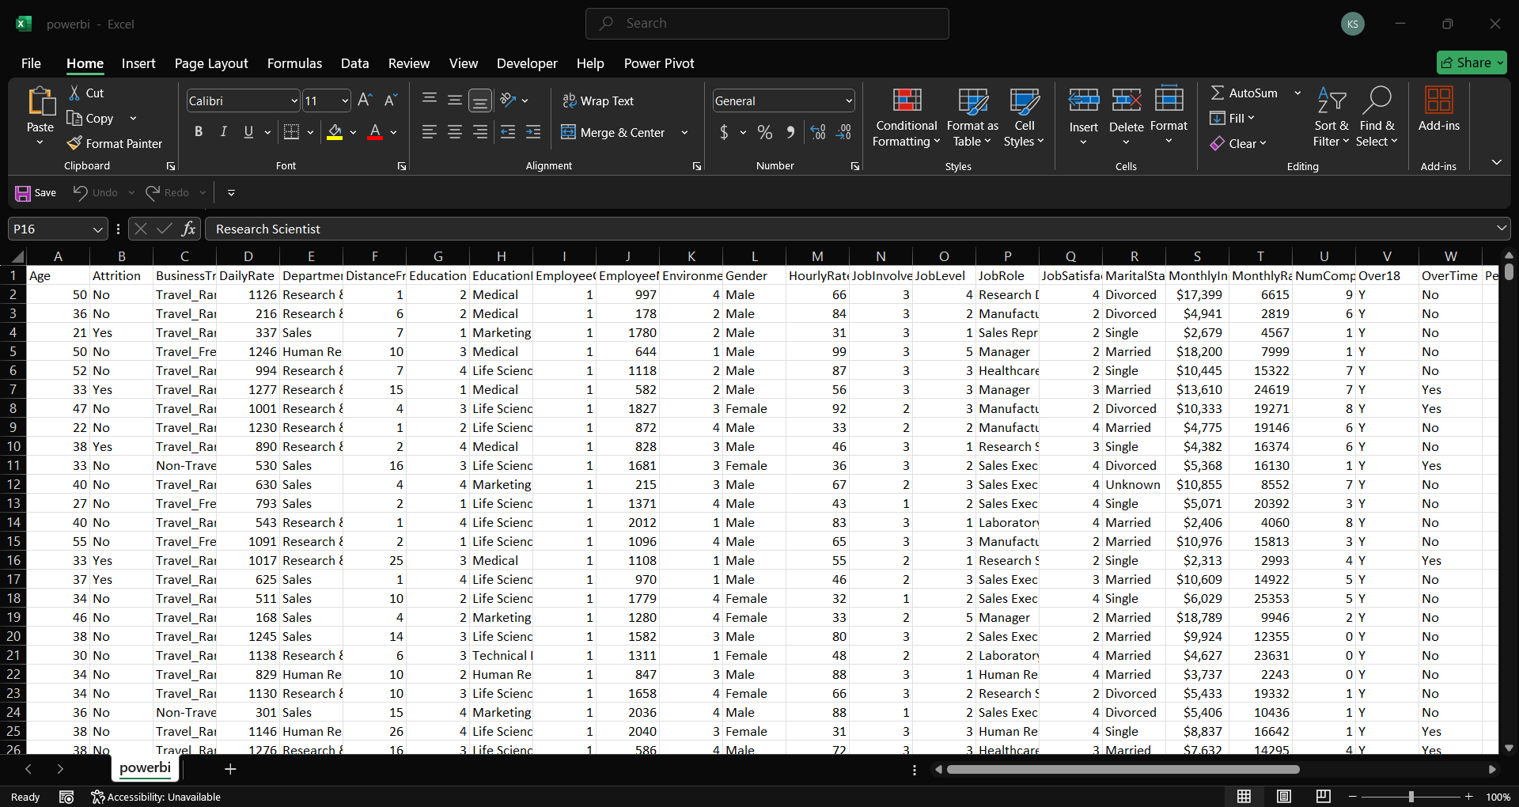
Data Cleaning:

Slide 6
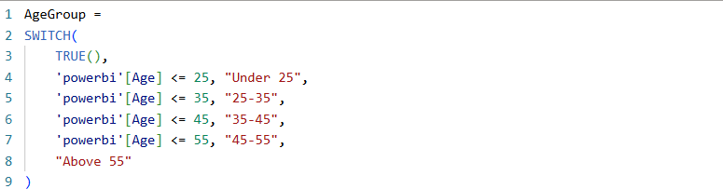
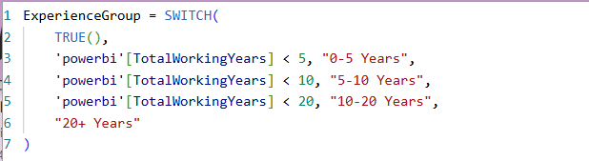
DAX Functions:

Slide 7


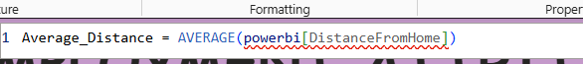


Slide 8
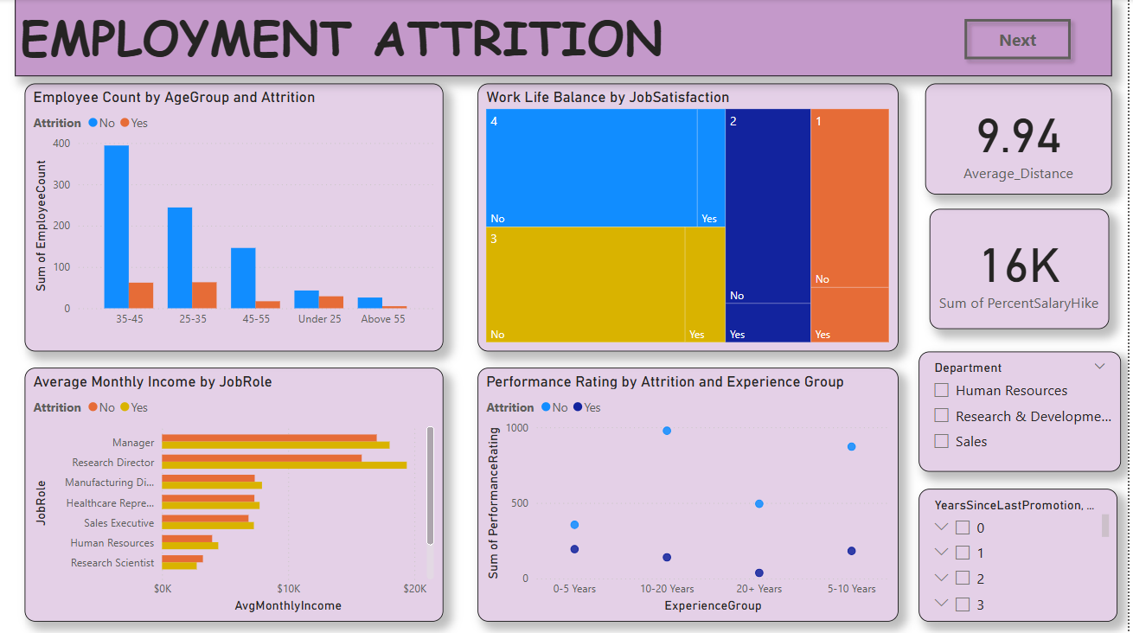

Slide 9
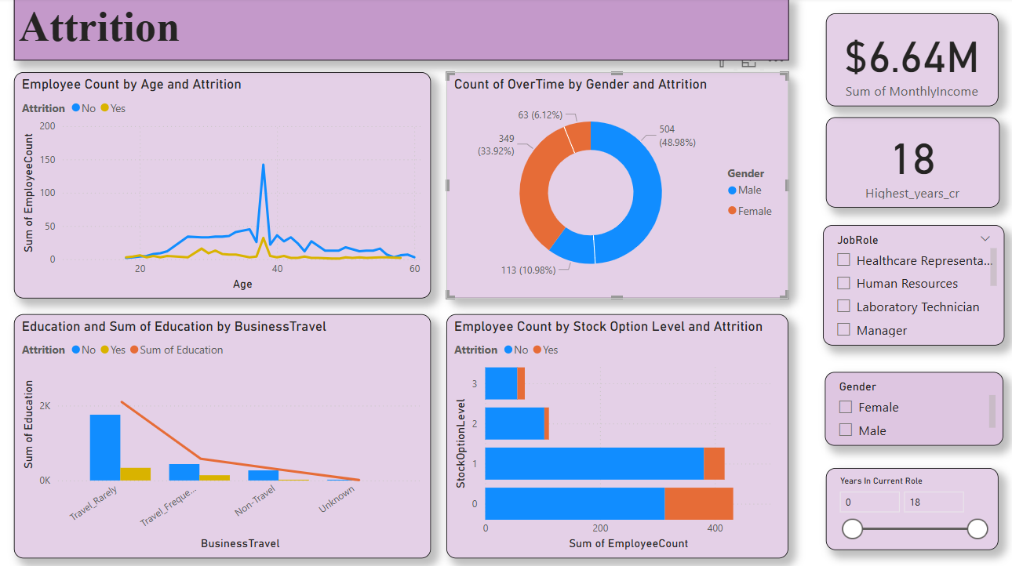

Slide 10
Insights:
Employee Count is highest around 35-45 sum of employee count is 334 without attrition, with attrition employee count is 62 and same in case of 25-35 it is 63.
Job satisfaction 3 is having the highest attrition of 140.
Job role of Research Director is having highest of attrition.
In case of experience group of 0-5 we have highest attrition.
At age of 32 there is highest attrition rate.
People who travel rarely are only having high attrition.
Male is having high attrition who is with overtime duty.

Slide 11

Thank You

